Slide 1

EDA of Hotel reservation Data
Soni Verma

Slide 2
Variables in Dataset
There is a total of 16 variables and I have taken a total of 8 variables to study the dataset.
Booking ID
No of adults
No of children
No of week Nights
No of weekend nights
Booking status
Lead time
Arrival time

Slide 3
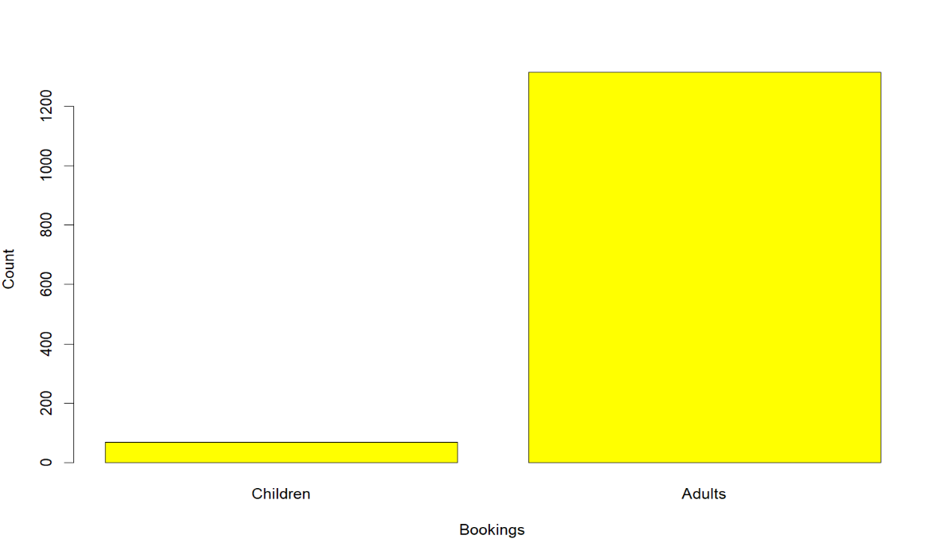
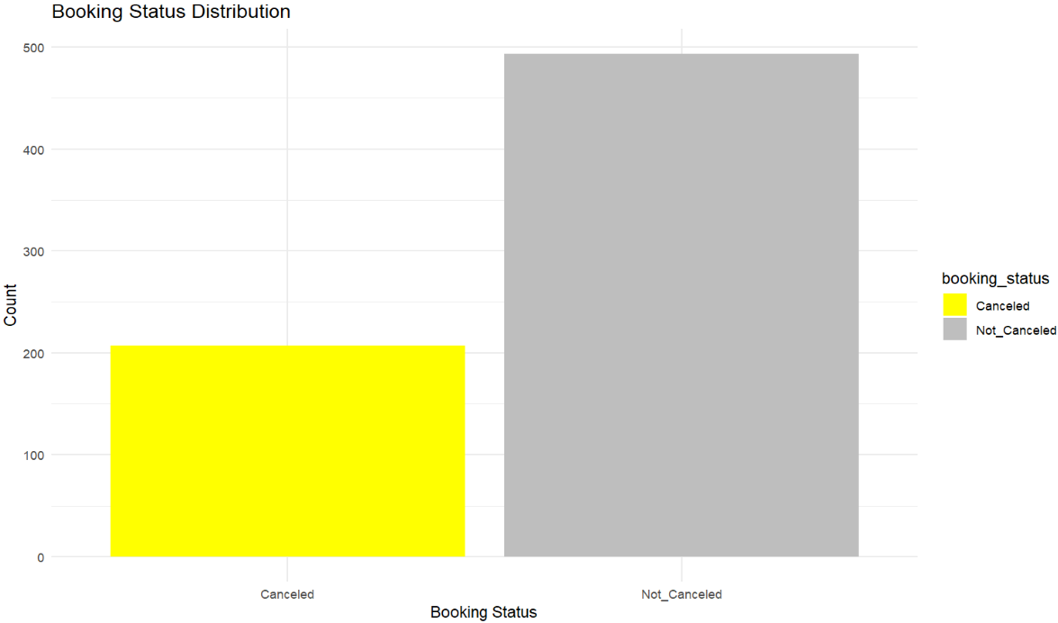
Plots of booking
No of bookings
Booking status

Slide 4
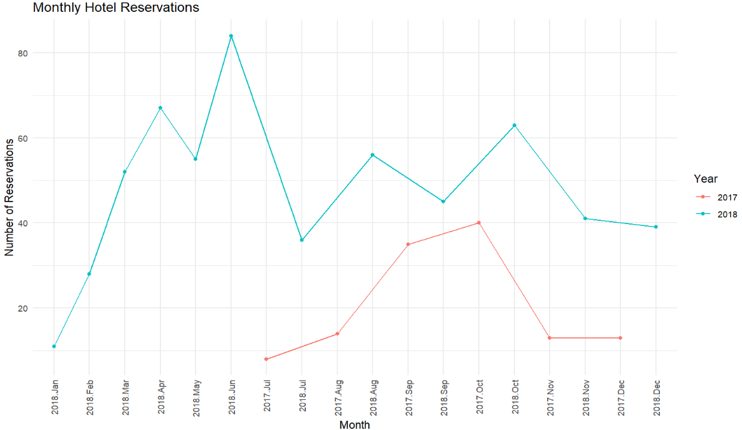
Reservation Timings

Slide 5
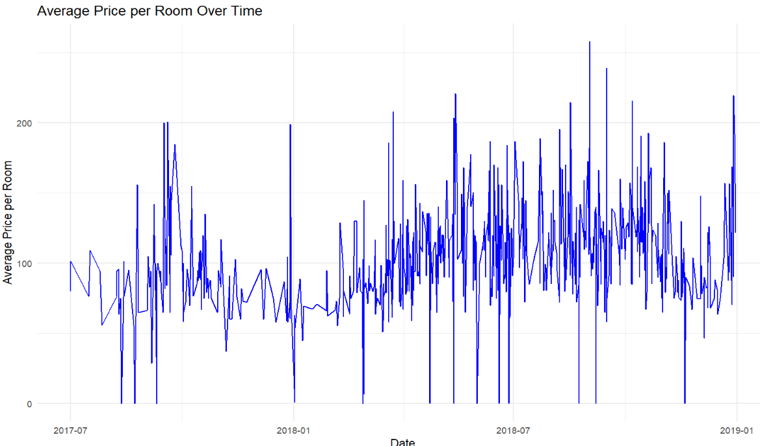
Average Price per Room Analysis

Slide 6
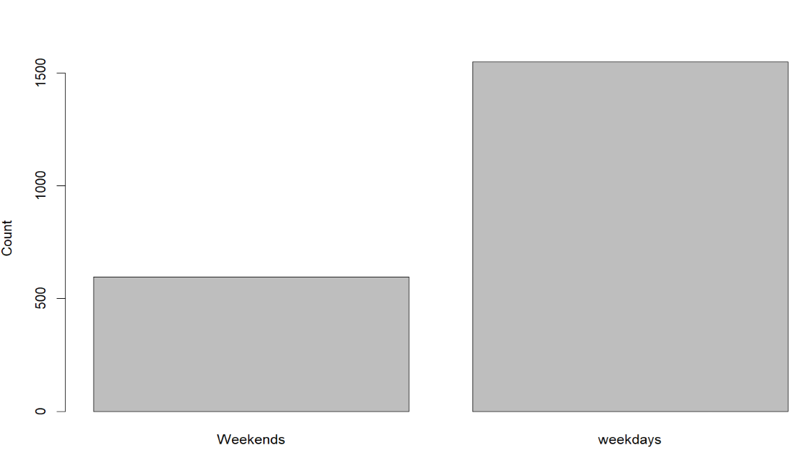
Booking Duration Analysis

Slide 7
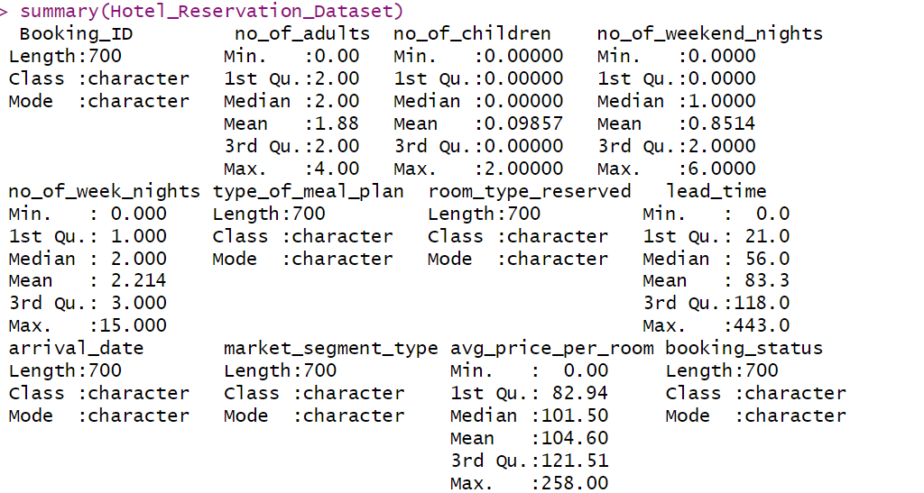
Summary of hotel reservation data

